Slide 1
OVERVIEW OF 8 MODULES OF THE MRV –IT TOOL – data FLOWS, REPORTING FORMATS, INTER-INSTITUTIONAL COLLABORATION
Development of Climate Change Monitoring, Reporting and Verification (MRV) System
December 14, 2021
Elisabeth Rigler, Team leader

Slide 2
Serbian monitoring, reporting and verification (MRV) system
Robust, efficient and purposeful MRV reporting system that fulfils the Paris Agreement transparency requirements and ensures the basis for EU reporting
Anchored in two national documents – Climate Change Law and the draft Climate Strategy with Action Plan
Governance structure consists of eight reporting modules –
GHG Inventory,
NDC,
Projections and Scenarios,
Policies and Measures (PAMs),
Adaptation to Climate Change,
Climate Finance,
National Reporting and
Indicators

Slide 3
MODULES OF FRAMEWORK FOR Monitoring, reporting and verification at the national level
MRV-IT system
NDC/LCDS/
LEDS
GHG INVENTORY
POLICIES&
MEASURES
National Reporting
MEP
SEPA
MEP/
Secretariat for public policies
MEP
Projections/
Scenarios
Adaptation Action
Climate Finance
Indicators
MEP
MEP
Secretariat for Public Policies/Ministry of Finance
SEPA, MEP

Slide 4
Mrv-it tool serves for:
Preparation and monitoring of implementation of low carbon strategies;
Iterative process of NDC planning, monitoring and reporting
3. Reporting of policies, measures and projections of GHG emissions, adaptation to climate change and climate finance;
4. Establishing a national inventory system for estimating anthropogenic GHG emissions by sources and removals by sinks not controlled by the Montreal protocol, and for reporting and archiving inventory information;
5. Reporting to the UNFCCC and to the EU at the later stage.

Slide 5
Based on UNFCC, EU and Serbian regulatory frameworks:
UNFCCC:
Decision 18/CMA.1 – Modalities, procedures and guidelines for the transparency framework for action and support referred to in Article 13 of the Paris Agreement
EU:
Regulation (EU) 2018/1999 on EU Governance and the
Implementing Regulation (EU) 2020/1208 on structure, format, submission process and review of information pursuant to Regulation (EU) 2018/1999 (EU) 749/2014.
SERBIA:
Zakon o klimatskim promenama (Law on Climate Change)
MPG
Implementing Regulation
By-laws

Slide 6
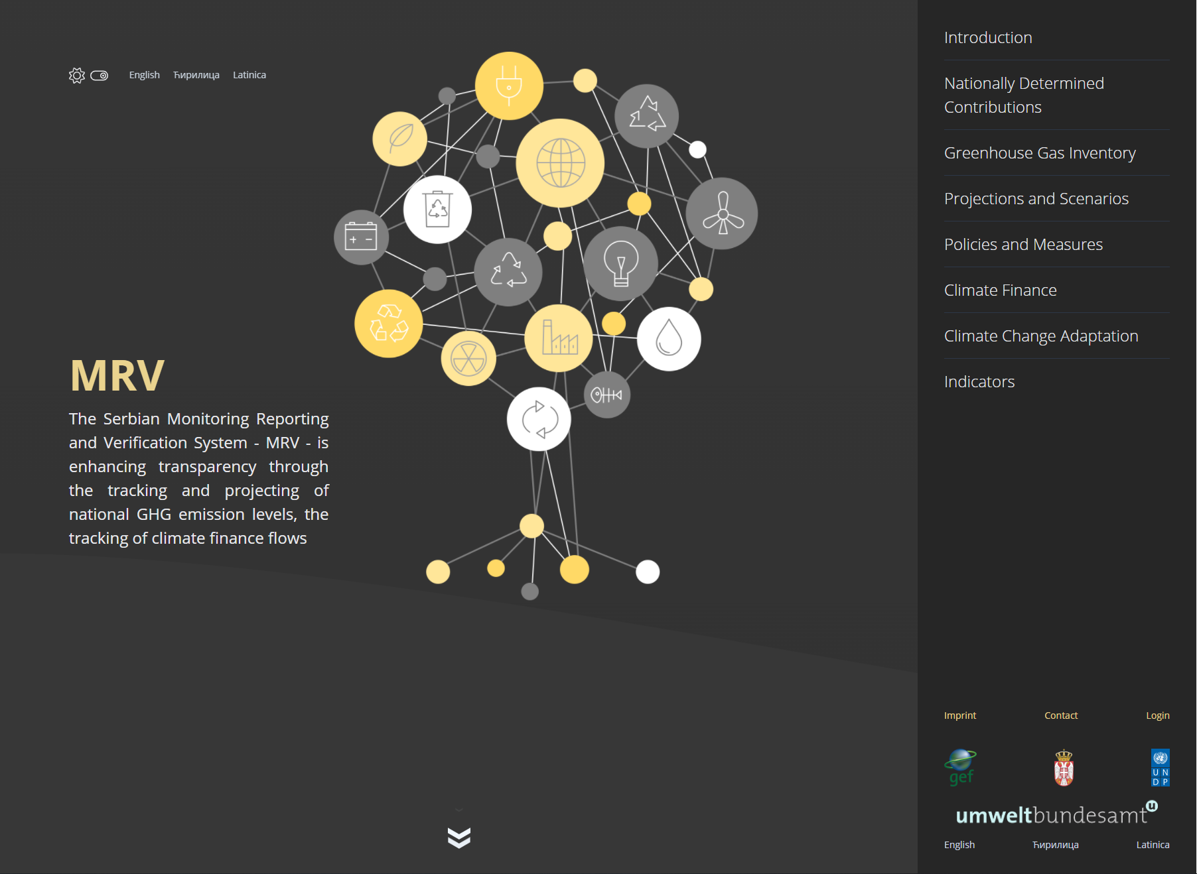
Based on UNFCC, EU and Serbian regulatory frameworks the MRV IT tool has a role to:
be used as a reporting tool
track progress towards meeting climate change related targets
data storage and exchange
information of newly stored data
collect documents and reports of MRV-relevance (comprehensive document repository)

Slide 7
MRV IT tool will, through its components, enable:
Data Acquisition Component: data processing
Reporting Component: reporting; reporting function to provide data in tables and graphs for use in word document, PDF and spreadsheet reports; templates provided an partly pre-filled
Collaboration Component: chats, emails, files
Administration Component: administration and maintenance

Slide 8
Data flows
NAP platform
SEPA
Statistical Office
Activity data upload
link
CRF upload
Activity data download
Other data providers
Adaptation
Climate finance
GHG inventory
manual
link
interface
NDC
manual
Targets
CUDS
Secretariat
interface
manual
Projections
link
interface
upload
PaMs
Ministry of Environment
Ministry of Energy

Slide 9
Inter-institutional collaboration
The MRV-IT tool enables raising the awareness about the reporting obligations towards the UNFCCC, the EU and the Serbian Climate Change Law
It also raises awareness about the MRV system and the opportunities for improved sectoral cooperation, better informed policy making and public participation
This particularly refers to other public institutions with climate-relevant policies and measures as well as IT systems that are already reporting on climate-relevant actions, such as the Secretariat for Public Policies, but also Institute for Statistics, Institutes for Nature Protection, Institute for Public Health, Hydrometeorological Institute, etc.
Central role of the Environment Agency, in charge of the GHG Inventory
Ministries of environment, energy, agriculture, transport, finance, interior, health, national and local administration contribute through the Secretariat or the Institute for Statistics
Other actors, such as regional and local Institutes and bodies, also those involved with Covenant of Mayors, Chamber of Economy, Industry and public companies (waters, forestry, etc.), NGOs and Standing Conference of cities and towns have their role either as data providers or users

Slide 10
Inter-institutional collaboration
MoEP and other ministries (scenarios, adaptation, PaMs, climate finance, NDC)
SEPA
(GHG inventory)
Secretariate of Public Policies
Local policies
Data providers
Other projects and databases (e.g. NAP)

Slide 11
Summary
MRV IT tool brings different actors of climate change related policy together and encourages cooperation and understanding of each other
It contains all relevant information on MRV of climate change and is therefore a valuable depository for data, reports and other relevant documents
It assists in fulfilling reporting obligations by providing relevant guidance and templates and by creating templates and graphs
It tracks Serbia´s progress in meeting its climate targets by presenting trends of past and projected emissions and indicators
….AND….
...it is the only such tool we know of in Europe ☺

Slide 12
GHG Inventory Module

Slide 13
Purpose:
To collect and merge information on historic GHG emissions from 1990 onwards
To enable Serbia to:
fulfil its international reporting obligations according to the UNFCCC (MPGs) and the EU Governance and its Implementing Regulation
perform a ex-post evaluation of its climate change policy by the use of indicators
To provide list of activity data used for inventory preparation
To visualise historic emissions trends (total and (sub-)sectoral)
To make historic emission trends publicly available

Slide 14
Ghg inventory module
Prepared according to the principles set out in 2006 IPCC Guidelines for National Greenhouse Gas Inventories, transparency, accuracy, consistency, comparability, and completeness on biennial basis by the Serbian Environment Protection Agency (SEPA).
• Covers the period 1990-2019, with 1990 as the base year for the estimation and reporting of inventories
Greenhouse gases reported on - CO2, CH4, N2O, HFC, PFC, SF6, NF3
• Also four indirect GHG: SO2, CO, NMVOC, NOx
• IPCC sectors: Energy, Industrial Processes and Product Use (IPPU), Agriculture, Land Use, Land-Use Change and Forestry (LULUCF), and Waste.

Slide 15
GHG inventory Module Reporting requirements - Summary
UNFCCC:
The modalities, procedures and guidelines (MPGs) for the transparency framework for action and support, referred to in Article 13 of the Paris Agreement are defined in Decision 18/CMA.1.
MPGs para. 17–58: National inventory report of anthropogenic emissions by sources and removals by sinks of greenhouse gases: GHG Inventory (data set) and National Inventory Report (NIR)
EU:
Governance Regulation (EU 2018/1999) and Implementing Regulation (EU 2020/1208):
Article 26: Annual reporting
Article 37: Union and national inventory systems
are fully in line with the Paris Agreement and MPGs
Serbian Climate Change Law
Article 57-61 GHG Inventory
Articles 62 to 65: A system for reporting on policies, measures and GHG projections shall be set up, kept, continuously improved and reported to the UNFCCC Secretariat

Slide 16
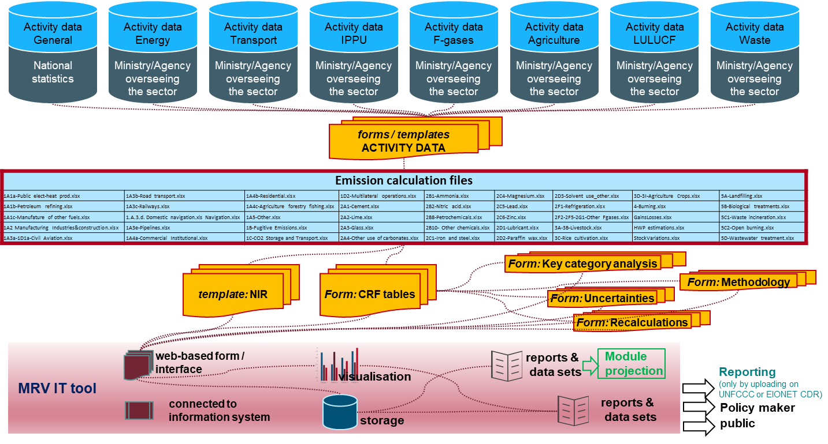
Emission data (inventory) to MRV IT tool: GHG Inventory

Slide 17
Projections & Scenarios module

Slide 18
Purpose
To collect and merge information on climate mitigation projections and scenarios
To assist and enable Serbia to fulfil its international reporting obligations according to the UNFCCC (MPGs) and the EU Governance and its Implementing Regulation
To visualise projected emissions trends (total and sectoral)
To make projections and scenarios publicly available

Slide 19
Projections & Scenarios module
Input data:
Scenarios (B2, M1-M4) as reported in Serbia´s long-term strategy
GHG emissions
Economic parameters (GDP, labour force, GVA, consumption expenditure per household)
Costs by policy/measure
Modelling parameters
Output files:
EU Reporting templates, partly prefilled with available information
Graphs: total and sectoral trends/scenario

Slide 20
Projections & scenarios Module Reporting requirements - summary
UNFCCC:
The modalities, procedures and guidelines (MPGs) for the transparency framework for action and support, referred to in Article 13 of the Paris Agreement are defined in Decision 18/CMA.1.
paras 92–102: Projections of greenhouse gas emissions and removals
EU:
Governance Regulation (EU 2018/1999) and Implementing Regulation (EU 2020/1208):
Article 39: Reporting on national projections
Annex XXIII of the Implementing Regulation
are fully in line with the Paris Agreement
reporting by 15th March 2021 and every two years thereafter; substantial changes to the information shall be communicated annually
Serbian Climate Change Law
Articles 62 to 65: Projections of greenhouse gas emissions and removals, and reporting

Slide 21
Policies and measures (PAMs) Module

Slide 22
Purpose
collect and merge information on climate mitigation policies and measures
enable Serbia to:
fulfil its international reporting obligations according to the UNFCCC (MPGs) and the EU Governance and its Implementing Regulation
monitor its progress towards its targets through a linking with the GHG inventory, the projections and the NDC module
make policies and measures publicly available

Slide 23
Policies and measures (PAMs) Module Implementation
Online questionnaire
according to Article 37 and Annex XXIV of the Implementing Regulation (2020/1208)
with predefined mandatory and optional fields
additional national relevant fields (e.g. responsible person, comments, implementation roadmap, access to information - open to public or restricted etc.)
Links within the MRV tool
to projections: within the PAMs questionnaire it must be indicated whether the measure is considered within an emission scenario (e.g. WEM or WAM); a query e.g. of WEM or WAM measures only is possible

Slide 24
Policies and measures (PAMs) Module Reporting requirements -summary
UNFCCC:
The modalities, procedures and guidelines (MPGs) for the transparency framework for action and support, referred to in Article 13 of the Paris Agreement are defined in Decision 18/CMA.1.
paras 80–90: Mitigation policies and measures
EU:
Governance Regulation (EU 2018/1999) and Implementing Regulation (EU 2020/1208)
are fully in line with the Paris Agreement
reporting by 15.March 2021 and every two years thereafter; substantial changes to the information shall be communicated annually
The EU templates for reporting on Policies and Measures can be found under the Annex 9.8 of Impl. Regulation
Serbian Climate Change Law
Article 63 - 65: A system for reporting on policies, measures and GHG projections shall be set up, kept and continuously improved

Slide 25
ADAPTATION MODULE

Slide 26
PURPOSE
To collect and compile information on adaptation to climate change that can be used for:
fulfilling Serbia’s international reporting obligations towards the UNFCCC (MPGs) and the EU Governance and its Implementing Regulation
Evidence-based decision-making process
make information on adaptation vulnerability, impacts and action publicly available

Slide 27
ADAPTATION Module
PUBLICALY AVAILABLE DATA AND INFORMATION:
Historical and projected climate data (National and Sub-national level) - NAP project
EEA Indicators
PAMs Adaptation + Adaptation Indicators (in Indicator part will be also)
NDC Adaptation – aa NDC document in NDC module
Link with CSUD project
Link with Loss&Damages – DES_Inventar
Documents: NAP, NC_Adaptation, LAPs, etc
Templates: indicators and PAMs (planning&reporting)

Slide 28
ADAPTATION Module – Reporting Requirements - SUMMARY
UNFCCC:
The modalities, procedures and guidelines (MPGs) for the transparency framework for action and support, referred to in Article 13 of the Paris Agreement are defined in Decision 18/CMA.1.
IV. Information related to climate change impacts and adaptation under Article 7 of the Paris Agreement (para. 104-117)
Also includes loss and damage
EU:
Governance Regulation (EU 2018/1999) and Implementing Regulation (EU 2020/1208)
are fully in line with the Paris Agreement
Reporting on adaptation actions: from March 2021, every 2 years, Annex VIII, Part 1.
Serbian Climate Change Law
Art. 6, and specifically Art. 13-15

Slide 29
Climate Finance Module

Slide 30
PURPOSE
To collect and compile information on climate finance that can be used for:
Fulfilling Serbia’s international reporting obligations according to the UNFCCC (MPGs) and the EU Governance and its Implementing Regulation
Evidence-based decision-making process
Making information on climate financing publicly available

Slide 31
Climate FINANCE Module
Article 9 of the Paris Agreement stipulates that developed country Parties shall provide financial resources to assist developing country Parties.
This support has to be reported transparently:
provide transparent and consistent information on support for developing country Parties provided and mobilised through public interventions biennially.
● developed country Parties shall
● other Parties are encouraged to
provide (transparent and consistent) information on support needed and received biennially.
● developing country Parties should
Notes:
The Convention and the Paris Agreement foresee financial assistance from Parties with more resources to those less endowed and more vulnerable.
Reporting requirements have been specified further in the Modalities, Procedures and Guidelines (MPGs) for the Enhanced Transparency Framework (Decision 18/CMA.1) from 2018.
1st reporting will have to be done in 2024.

Slide 32
Climate finance MODULE document repository
Share all available information on climate finance, e.g.
List of support needed from the Second National Communication / First Biennial Update report (available)
Analysis of climate-related expenditure in Serbia in the years 2016-2018 (available)
Future reports to the UN and the EU on support needed and received / provided
Publish selected documents (transparency)

Slide 33
Climate Finance Module – Reporting Requirements - summary
UNFCCC:
The modalities, procedures and guidelines (MPGs) for the transparency framework for action and support, referred to in Article 13 of the Paris Agreement are defined in Decision 18/CMA.1.
VI. Information on financial, technology development and transfer and capacity-building support needed and received under Articles 9-11 of the Paris Agreement (para. 130-145)
EU:
Governance Regulation (EU 2018/1999) and Implementing Regulation (EU 2020/1208)
are fully in line with the Paris Agreement
Currently not relevant for Serbia as requirements only refer to financial support (and technology development and transfer and capacity building) provided
Serbian Climate Change Law
Does not specifically mention this.

Slide 34
NDC MODULE

Slide 35
Purpose
To monitor and visualise progress towards 2030 targets
To make current version of NDC publicly available

Slide 36
NDC Module (input parameters)
The NDC module combines
Data:
Historic GHG emissions trends (1990-) from GHG emission module
GHG emission scenarios (B2, M1-M4) from projection module
NDC targets (relative, conditional)
and tracks Serbia´s progress towards meeting it´s NDC target.
Reports:
NDC report

Slide 37
NDC Module Reporting requirements - summary
UNFCCC:
The modalities, procedures and guidelines (MPGs) for the transparency framework for action and support, referred to in Article 13 of the Paris Agreement are defined in Decision 18/CMA.1.
MPGs para. 59-103: III. Information necessary to track progress made in implementing and achieving nationally determined contributions under Article 4 of the Paris Agreement
Additionally, Decision 4/CMA.1, Annex I – clarity on NDC and Annex II – accounting for NDC and Decision 6/CMA.1 – common timeframe for NDCs and 9/CMA.1 on adaptation are also relevant
EU:
Governance Regulation (EU 2018/1999) and Implementing Regulation (EU 2020/1208):
are fully in line with the Paris Agreement and MPGs
Serbian Climate Change Law
Only generally in Art. 3 on implementation of the Paris Agreement

Slide 38
NATIONAL REPORTING MODULE

Slide 39
Purpose
To display NR-relevant policies and measures
To display NR-relevant climate change adaptations

Slide 40
Thank you for your attention
Contact: Elisabeth Rigler, Team Leader (Elisabeth.rigler@umweltbundesamt.at)
Ivana Mijatovic, Transparency Expert (imijatovic005@gmail.com)

