Slide 1
General introduction of the MRV-IT tool
December 14, 2021 – Denis Mašinović

Slide 2
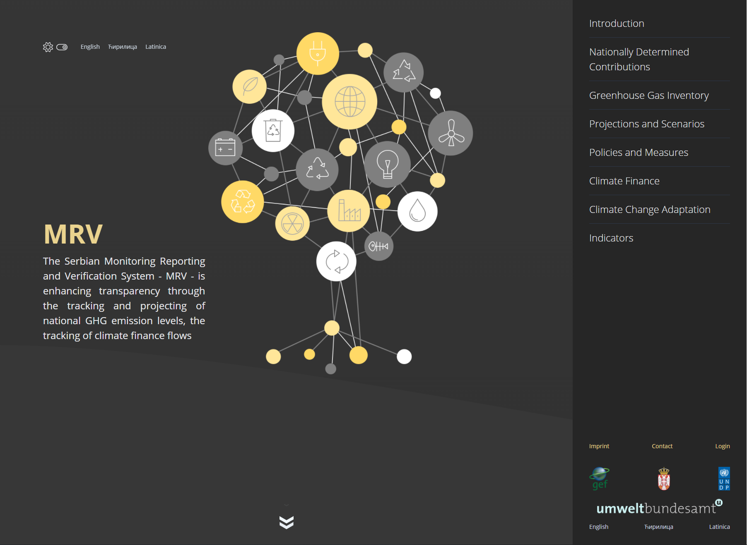
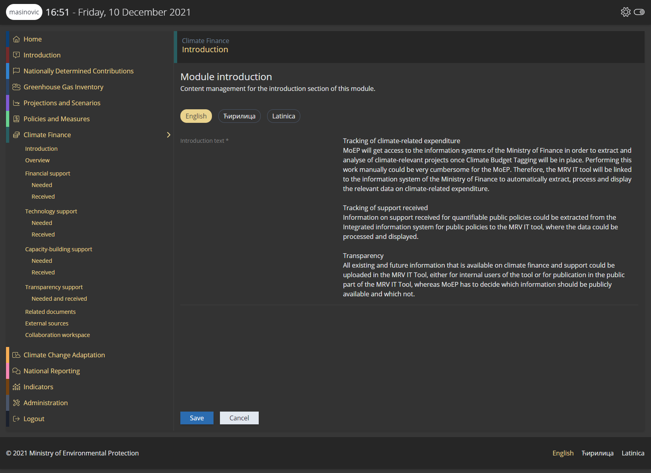
General introduction of the MRV-IT tool
Public view
Log-in and internal view
User administration
Roles and permissions
Module visibility
Module introduction content
Related documents
External sources
Collaboration workspace

Slide 3
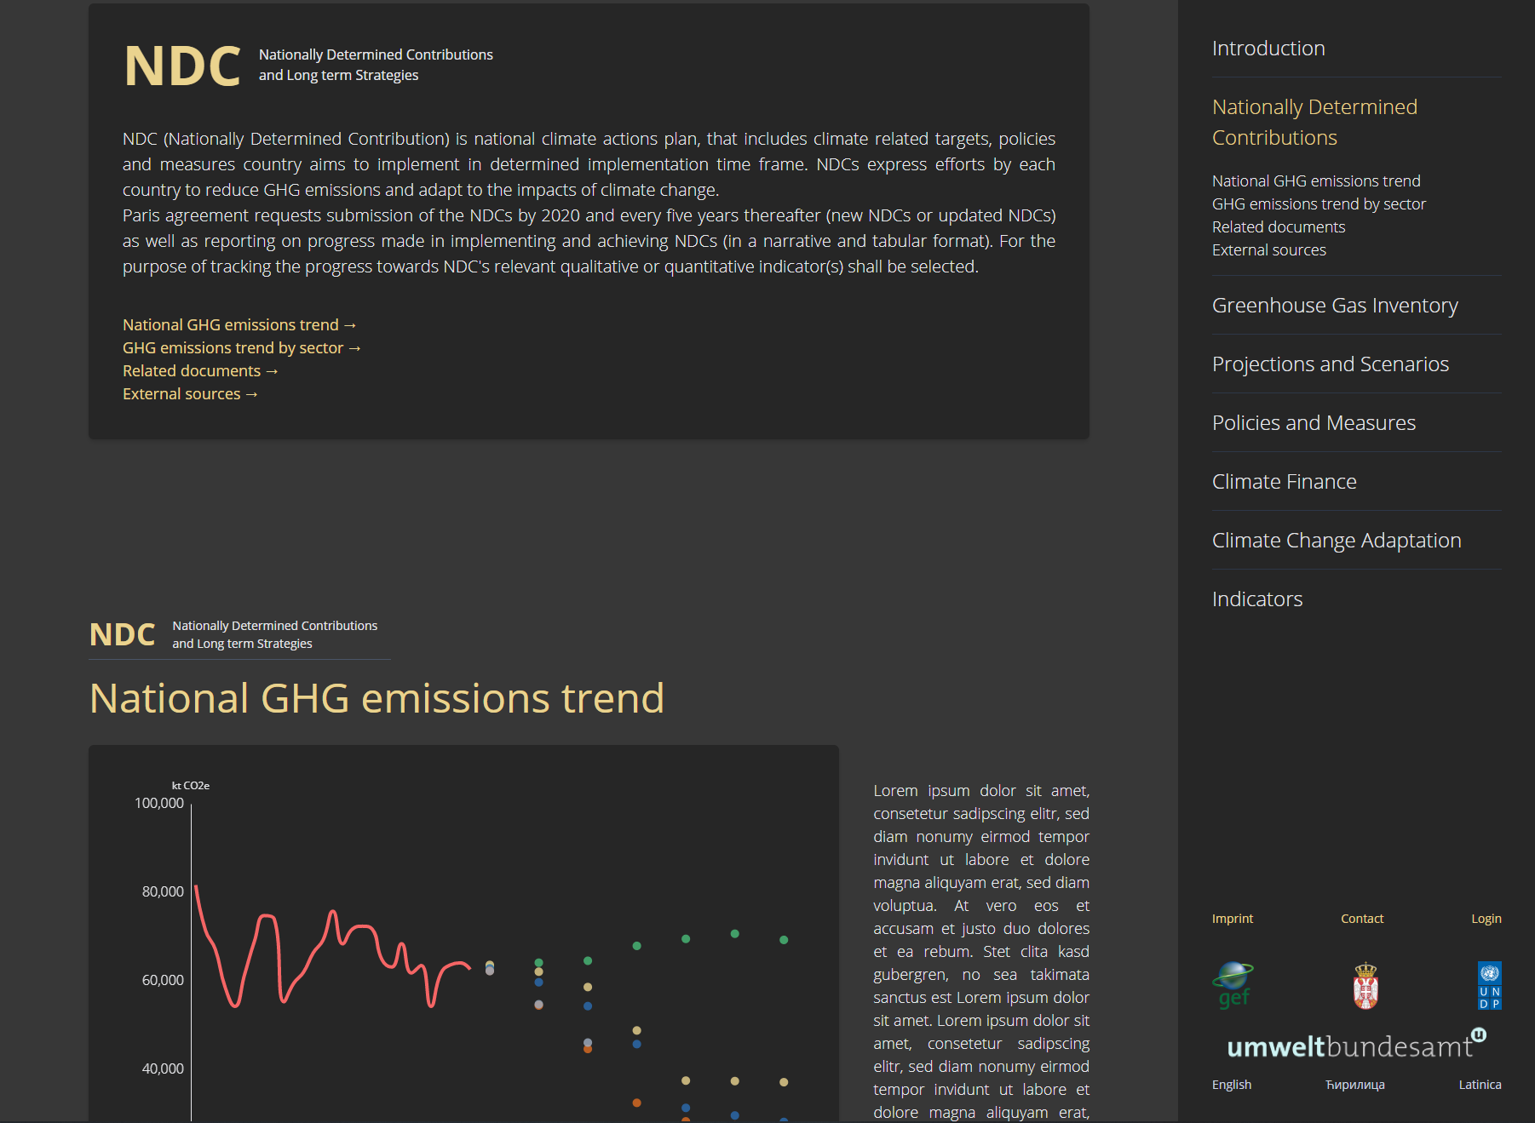
Public view
Information page for the public
Displayed modules can be configured
Displayed data can be configured

Slide 4
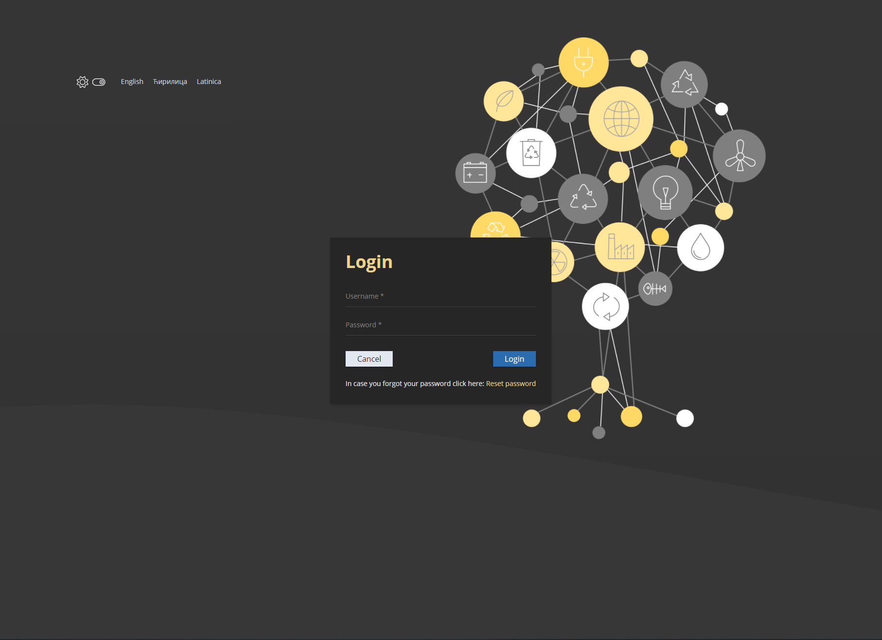
Log-in and internal view
Login (username / password)
Password reset
Home / Welcome screen
Public introduction text
Working modules
Administration

Slide 5
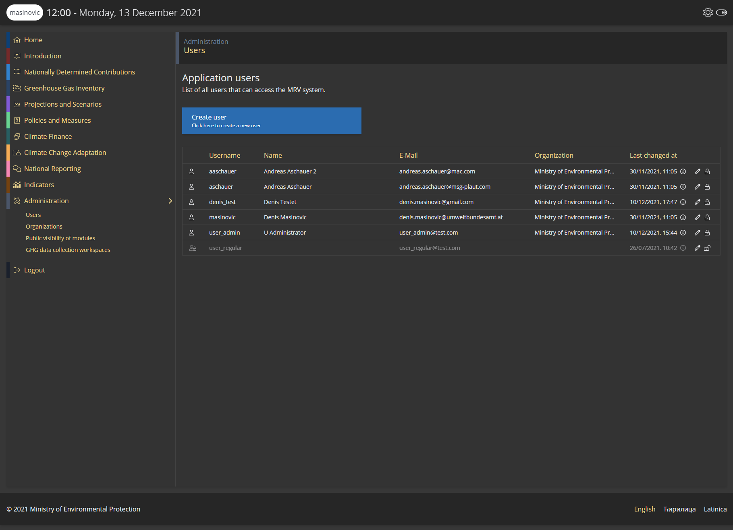
User AdministratioN
MRV user must have:
Unique username
Valid e-mail address
Organization membership
Group memberships
Users can be disabled and enabled

Slide 6
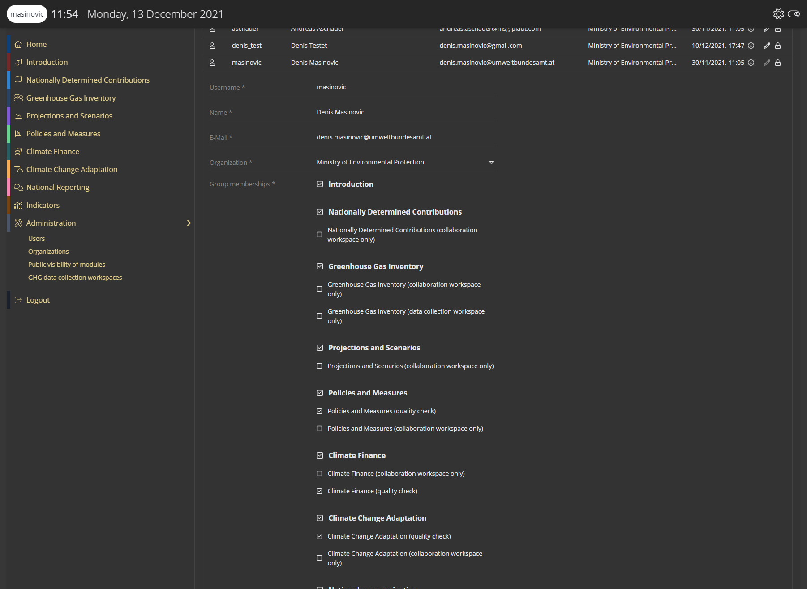
Roles and permissions
Primary roles
Have the same name as a module
Are displayed in bold in the user administration
Give the user full read / write permission to one module
Secondary roles
Give the user read permission to one module and write permissions to a specific part of the module
Collaboration workspace only Allows the user to create, edit and share documents in the collaboration workspace
Quality check Allows the user to mark data as quality checked

Slide 7
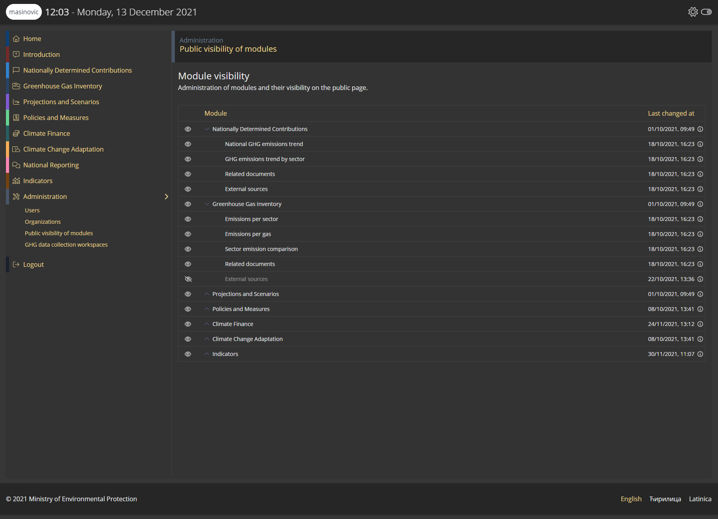
Module visibility
Configure which modules should be visible on the public page
Show / hide a whole module from public view
Show / hide only parts of a module from public view
Data from hidden modules is not available to the public

Slide 8
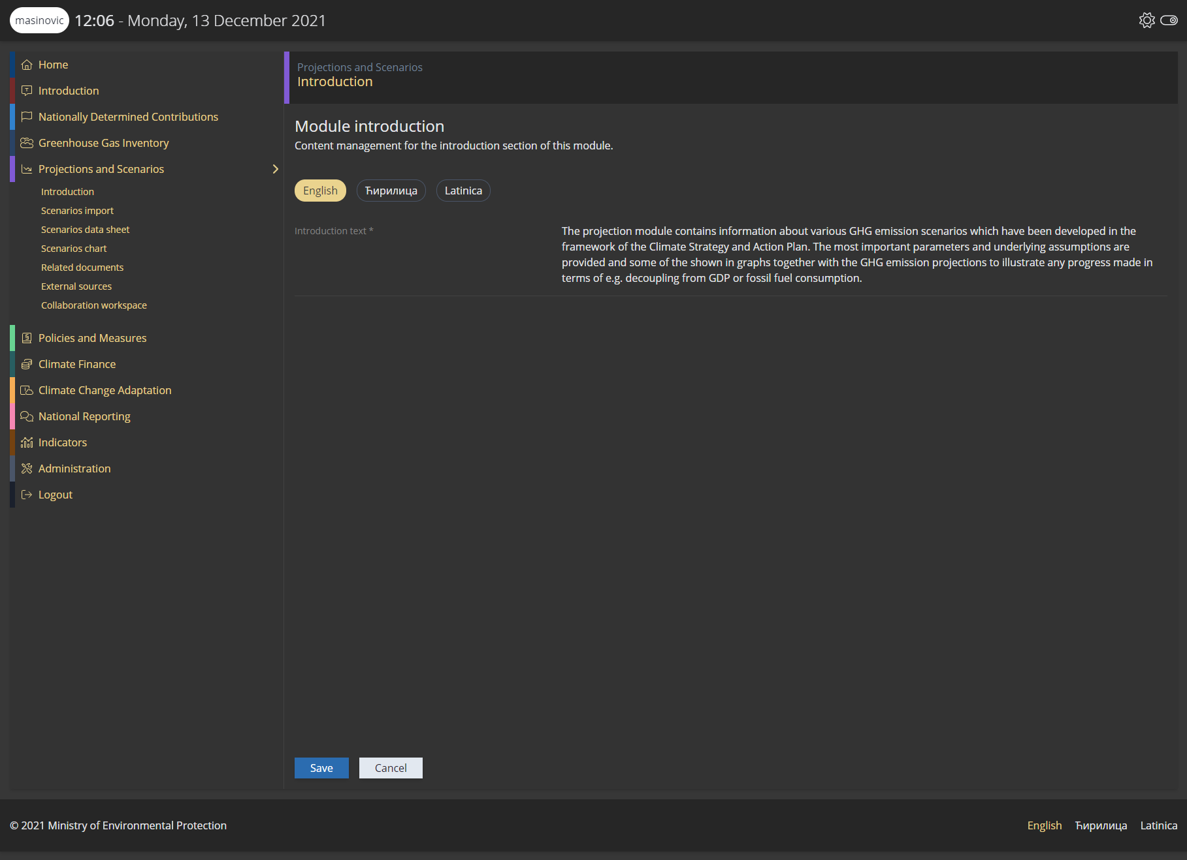
Module Introduction content
Each module has a introduction part on the public page which can be changed
Introduction text is saved in the languages
English
Serbian
Serbian (latinica)
Users with full module access can update the content

Slide 9
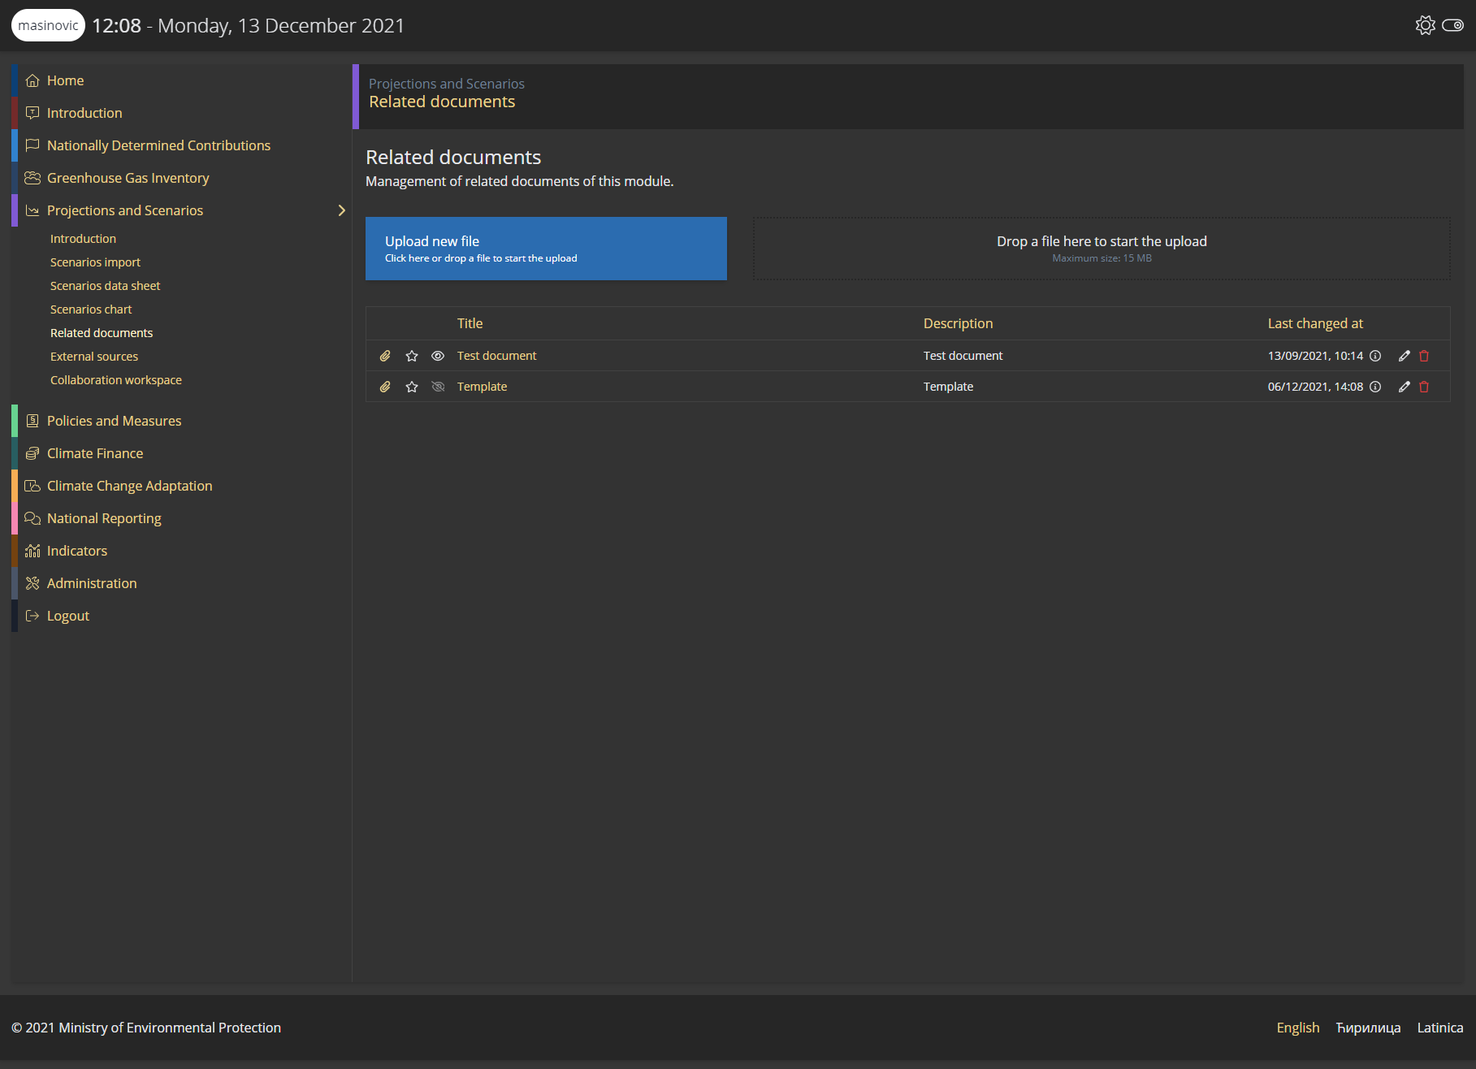
Related documents
Each module has external sources
External sources can be created, updated and deleted by users with full module access
External sources can be visible / hidden from the public
External sources can be marked as primary / important

Slide 10
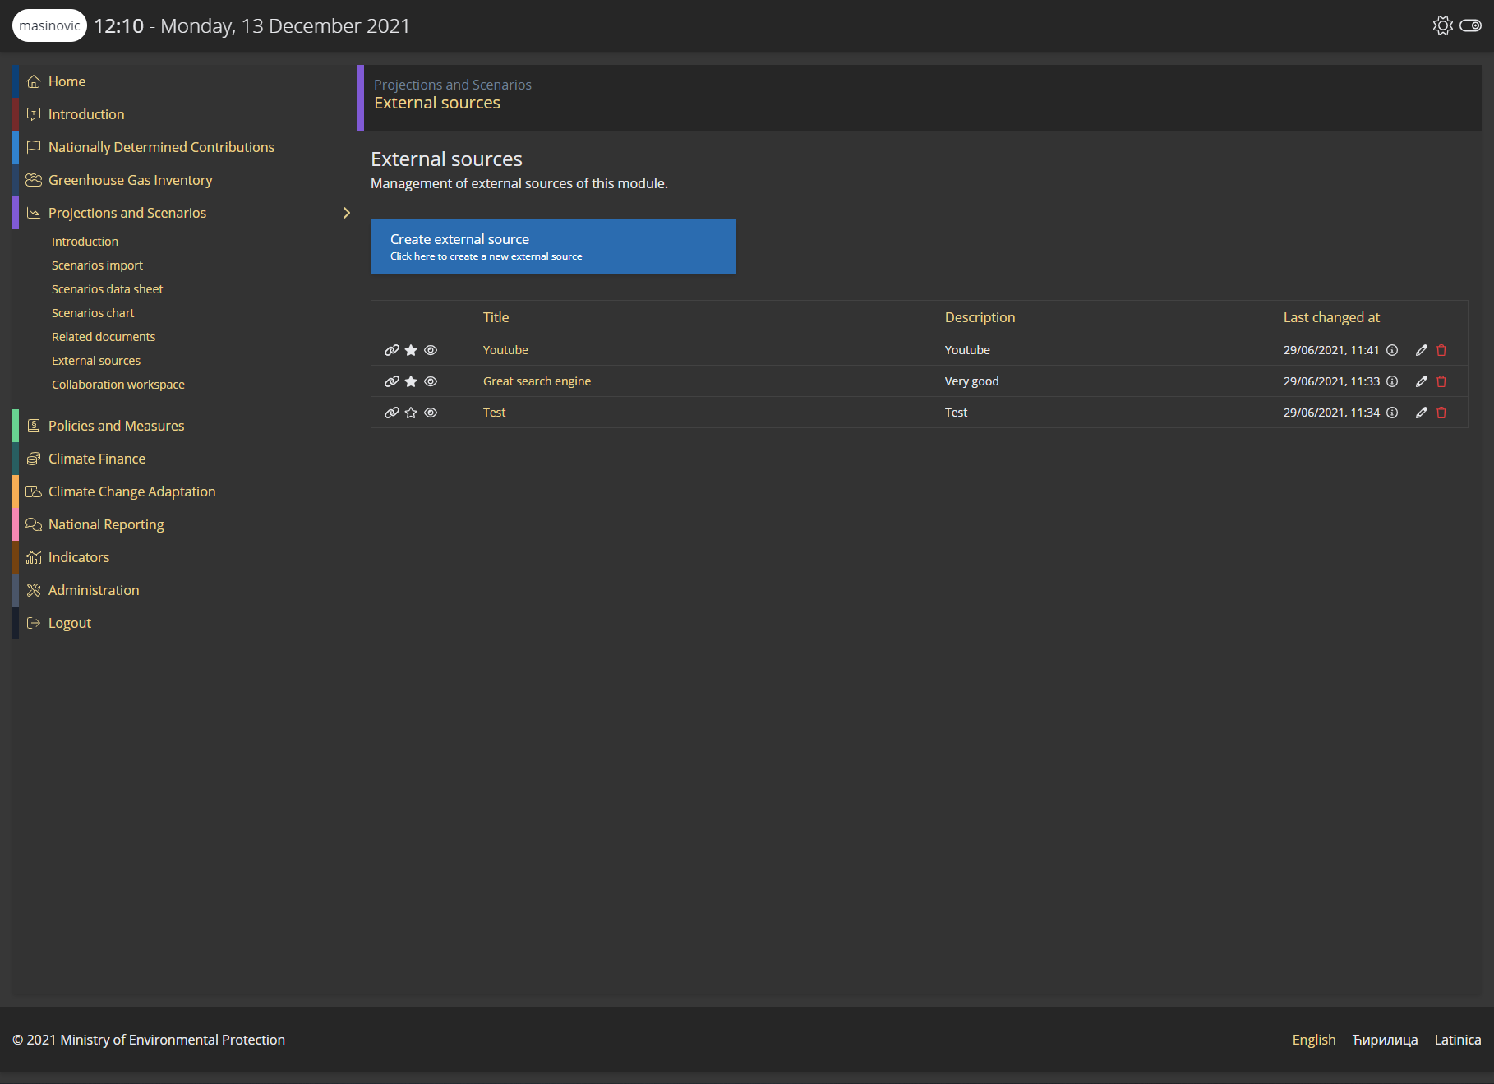
External sources
Each module has related documents
Related documents can be created, updated and deleted by users with full module access
Individual documents can be visible / hidden from the public
Individual documents can be marked as primary / important

Slide 11
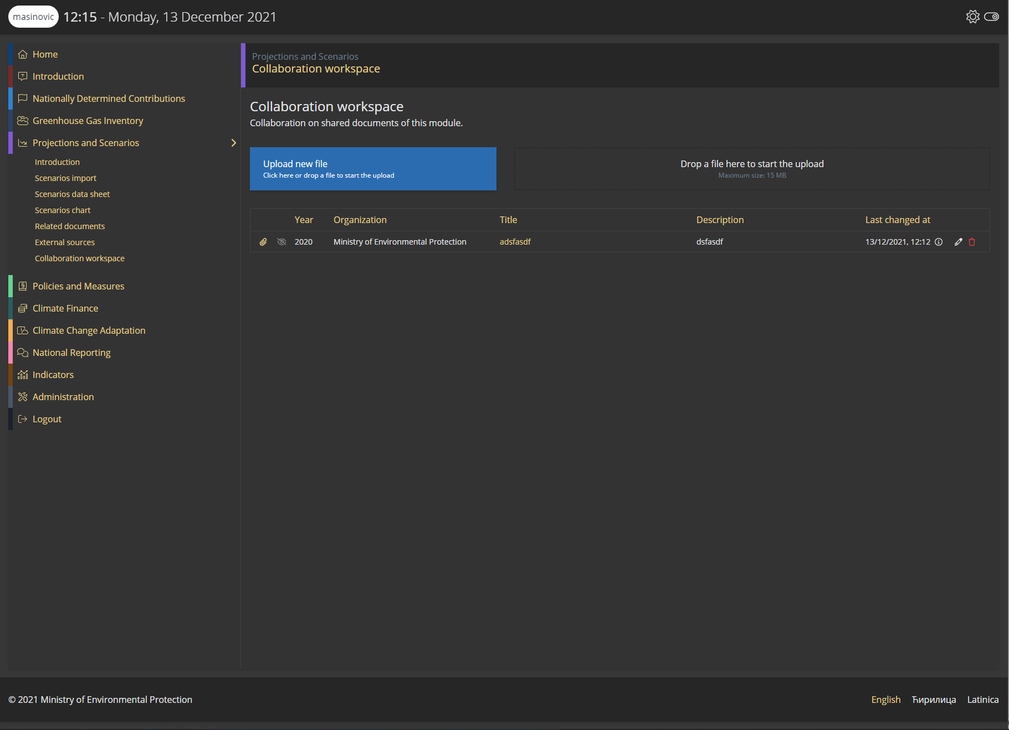
Collaboration workspace
Each module has a collaboration workspace
Documents in this workspace are NOT publicly visible
Uploaded documents from other organizations are only visible to
Organization that uploaded the document
Ministry of Environmental Protection
Documents can be made visible to all organizations by the uploading organization

Slide 12
Contact & Information
Denis Mašinović
denis.masinovic@umweltbundesamt.at
Environment Agency Austria www.umweltbundesamt.at
Training MRV Zoom  14.+15.12.2021

