Slide 1
Application of the CBIT-GSP Template
for the National Inventory Document
5 June 2025
Jaypalsinh Chauhan
CBIT GSP Asia Network Coordinator

Slide 2

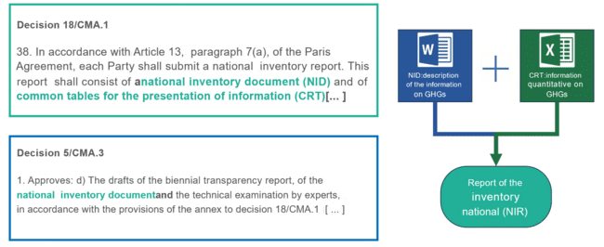

Introduction to the National Inventory Document

Slide 3
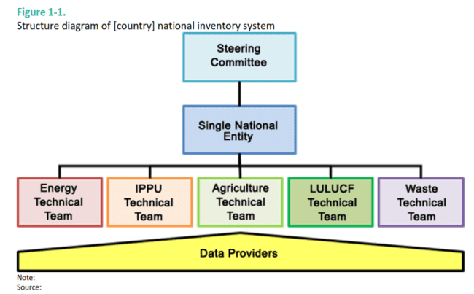
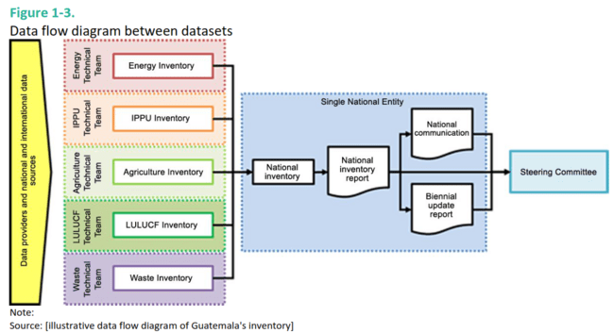
Introduction to the National Inventory Document
The guidelines provided should not be considered mandatory, as countries must ultimately report information in accordance with the MPG.
The template only suggests possible approaches and examples according to the good practices that have proven useful for countries.
Each table and figure included will have to adapt to the national circumstances of each country.
The template is extensive (more than 300 pages), because it attempts be as exhaustive as possible, each country will be able to edit it to remove what is not relevant to its national circumstances.

Slide 4
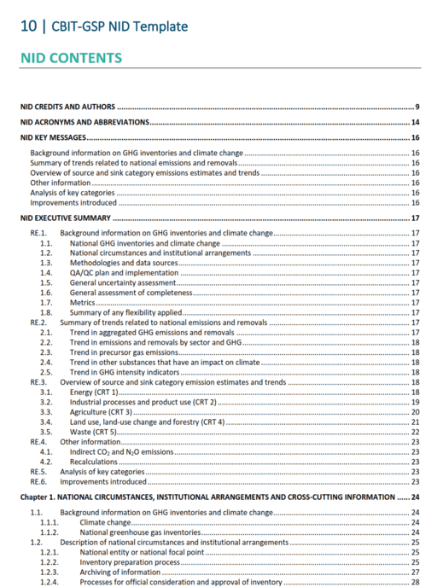
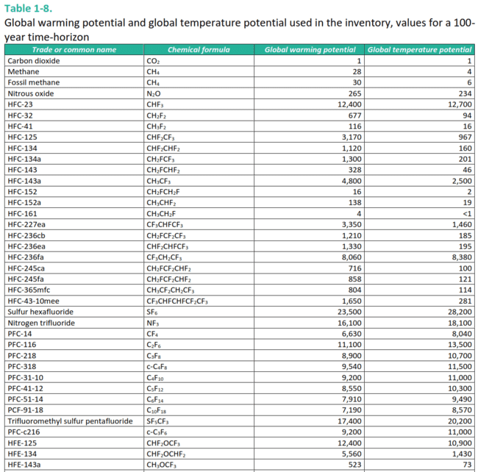
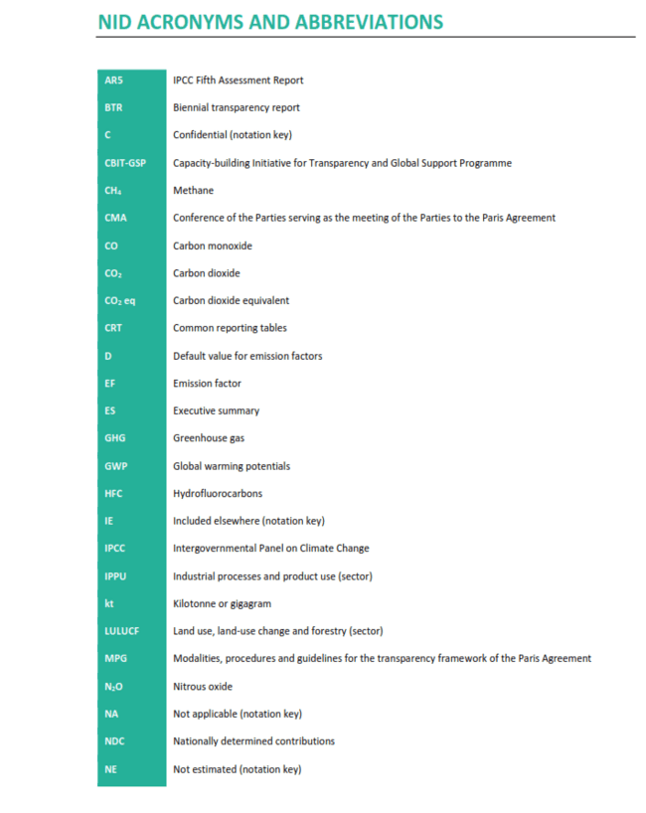
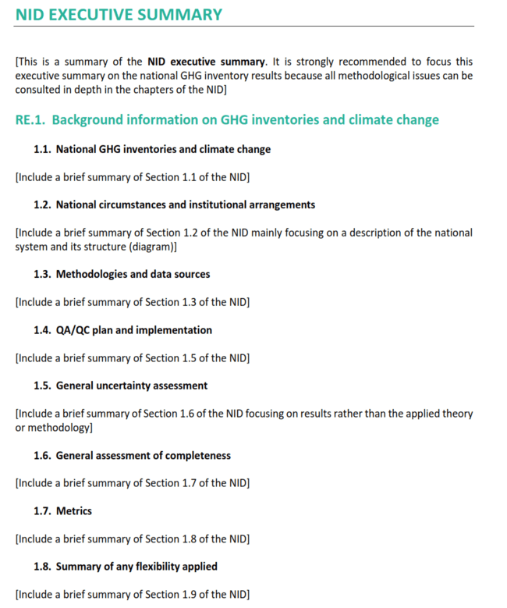
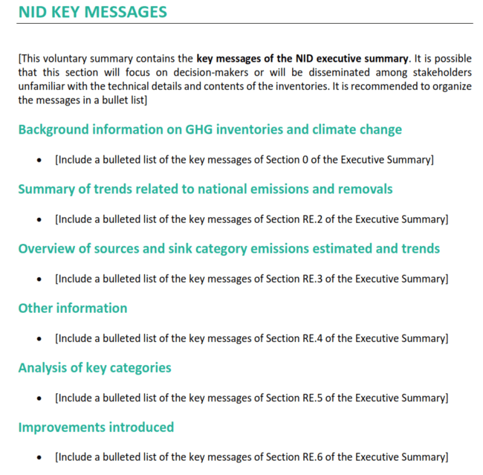
Introduction to the National Inventory Document

Slide 5
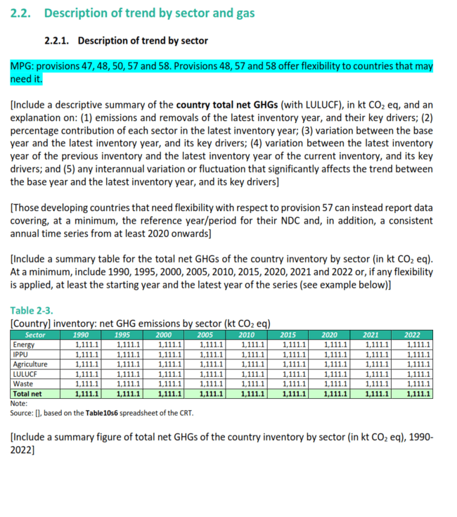
Introduction to the National Inventory Document
The document, prepared by CBIT-GSP based on the experience of the RedINGEI, provides a standardized and editable NID template and the chapter on inventory that can be included in BTRs and NCs.
The template includes a proposed structure for the NID and one description of the minimum contents that each section should address, including tables and figures.
Each section (where applicable) includes a number highlighted fonts which refers to the provision of the MPG that is being complied with and, if applicable, flexibility.

Slide 6
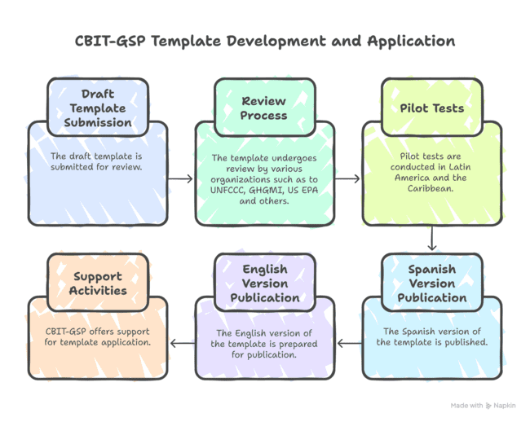
Review, publication and support for your application
The draft template was submitted to a review process by the UNFCCC, GHGMI, US EPA, among others.
Carried out pilot tests with countries of the Climate Transparency Network for Latin America and the Spanish speaking Caribbean.
The editable Spanish version has already been published in the Climate Transparency Platform .
The editable English version is about to be published.
CBIT-GSP offers support activities for the template application with the aim of supporting countries in development and timely presentation of your NIR.

Slide 7

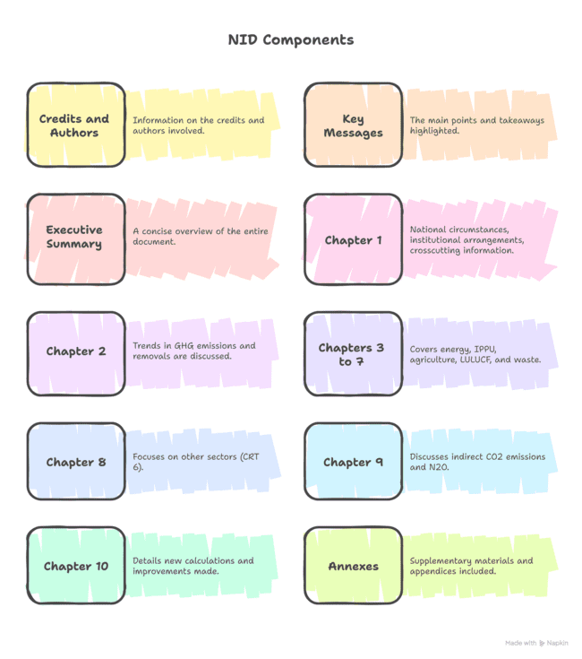
Structure of the CBIT-GSP Template for the NID

Slide 8
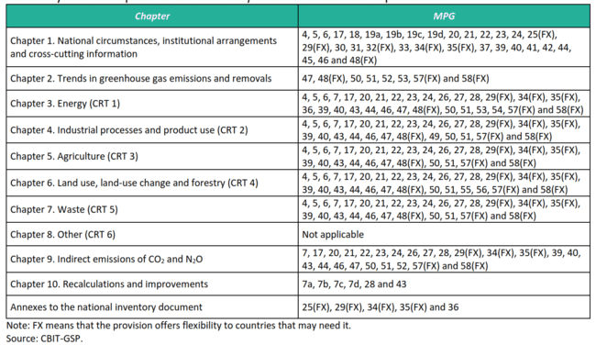
Structure of the CBIT-GSP Template for the NID

Slide 9
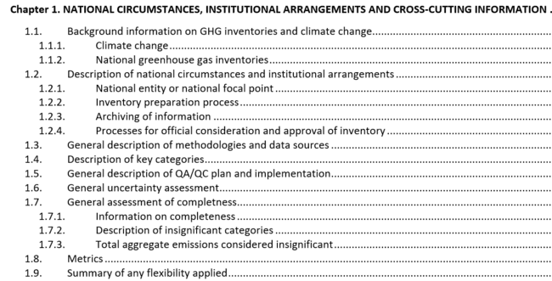
Chapter 1. National circumstances, institutional arrangements and cross-cutting information

Slide 10
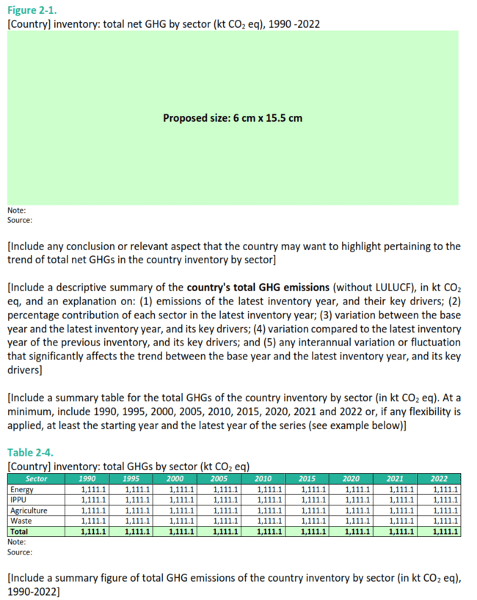
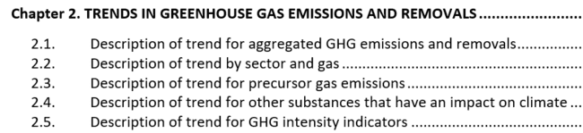
Chapter 2. Trends in GHG emissions and removals

Slide 11
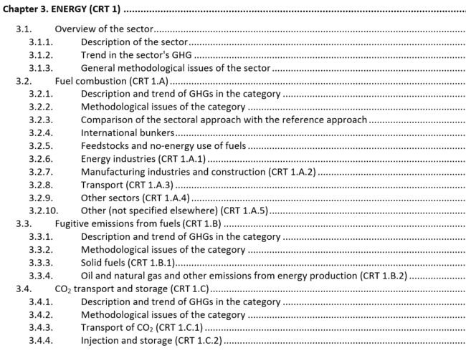
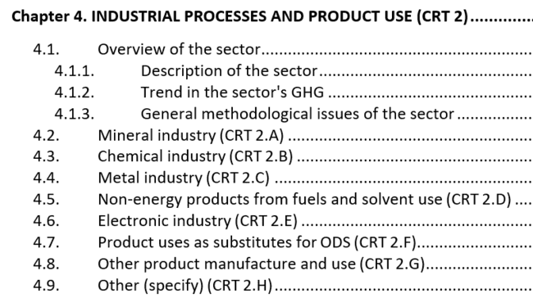
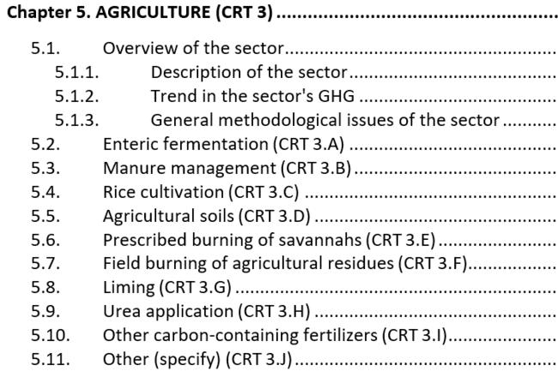
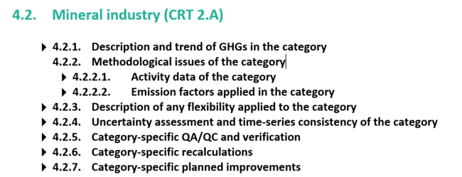
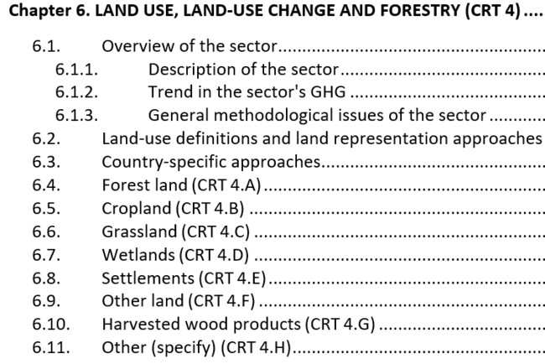
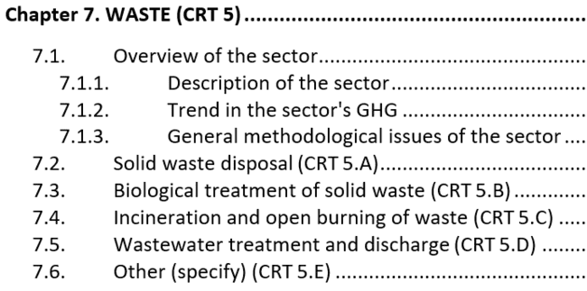
Chapters 3-7. Energy; IPPU; Agriculture; LULUCF; Waste
X.1. General overview of the sector
X.2. Category (CRT XX)
XX1. Description and trend of GHGs in the category
XX2. Methodological aspects of the category
XX3. Description of any flexibility applied in the category
XX4. Uncertainty and consistency of the category time series
XX5. AC/CC and category verification
XX6. New category calculations
XX7. Planned improvements for the category

Slide 12
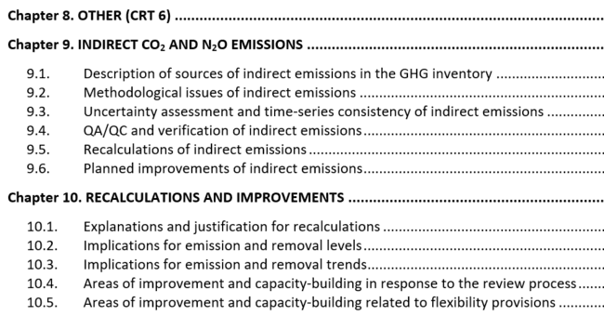
Chapter 8-9-10. Other; Indirect CO₂ and N₂O Emissions; Recalculation and Improvements

Slide 13
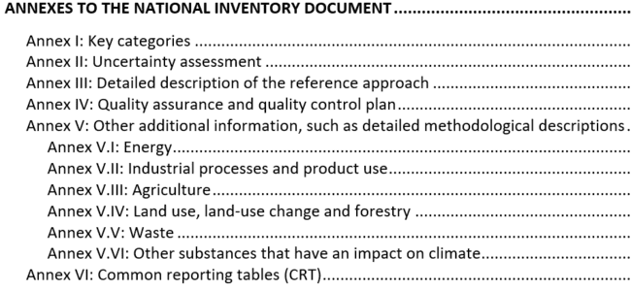
Annexures to the NID

Slide 14
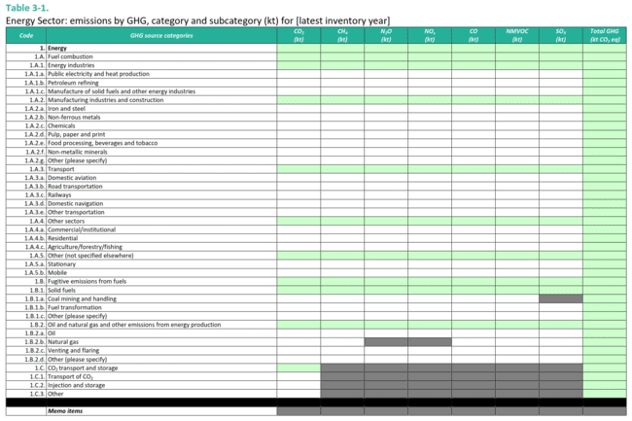
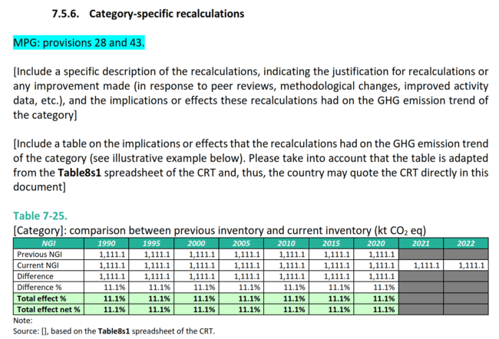
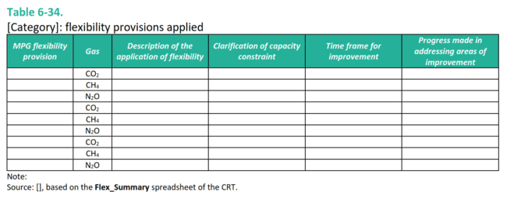
Annexures to the NID

Slide 15


Discussion
Q&A

Slide 16

Thank you for your attention !
www.climate-transparency-platform.org
Please reach out to us for any question, comments or suggestions!
For more information:
https://climate-transparency-platform.org

