Slide 1
CBIT Closing Conversation Series: A Deep Dive into Georgia's NDC Tracking System
Kakha Mdivani
Wednesday
29 April 2024

Slide 2
Climate Change Online Data Management System
Owned by the Ministry of Environmental Protection and Agriculture of Georgia
Purpose
Drivers
Functions
Outcomes

Slide 3
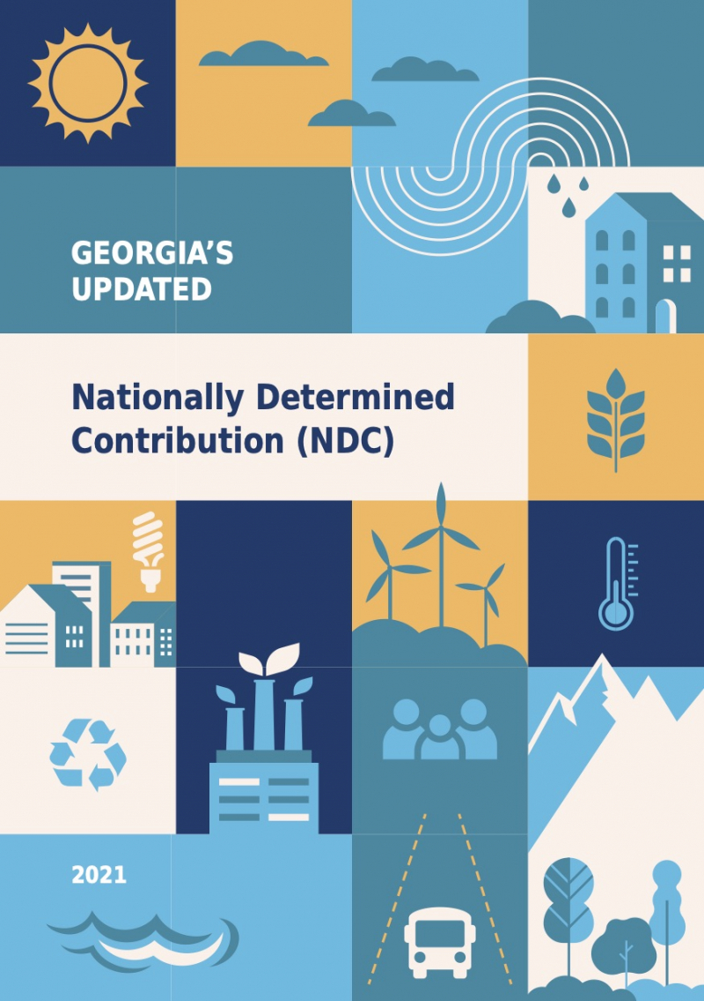
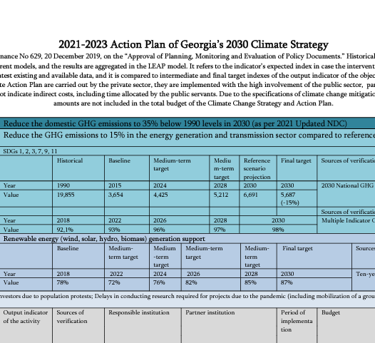
Drivers
Nationally Determined Contribution of Georgia
Georgia is fully committed to an unconditional limiting target of 35 % below 1990 level of its domestic total greenhouse gas emissions by 2030;
Georgia’s 2030 Climate Change Strategy
6 Sector: Energy, Transport, Building, Industry, Agriculture, Waste for achieving NDC Goal;
1 Sector: Forestry increase Carbon sink capacity
Georgia’s 2021-2023 Action Plan (CAP)
66 Mitigation measure for achieving NDC Goal and fulfilling Strategy sectoral objectives

Slide 4
Drivers
Example
Energy Generation Sectoral Goal
NDC
15% GHG emission reduction compeering to the WoM scenario
CAP
5
Build HPPs by 2024
HPP
by
2024
Ministry of Economy
HPP 1 – 51 MWh
HPP 2 – 47 MWh
HPP 3 – 53 MWh
HPP 4 – 20 MWh
HPP 5 – 26 MWh
Activity
Indicator
Responsible

Slide 5
Function
Climate Change Online
Data Management System
Example
5
HPP1
HPP2
HPP3
HPP4
HPP5
HPP
by
2024
Investor Selection Delay Under Construction
Under Construction Exploited
NO NO NO NO NO
NO NO NO Documentation
from the Ministry of Economy
Site Selection Under Construction Exploited
Indicator
Person
2021
2022
2023

Slide 6
Function
Climate Change Online
Data Management System
Example
5
HPP1
HPP2
HPP3
HPP4
HPP5
Under Construction
$$\frac{2}{5}$$
HPP
by
2024
Exploited
73 MWh
NO
Documentation
Exploited
Indicator
2023

Slide 7
Function
Climate Change Online
Data Management System
Example
MPGs
5
HPP1
HPP2
HPP3
HPP4
HPP5
HPP
by
2024
Para 75 (g). Methodologies used to track progress arising from the implementation of policies and measures
from the Ministry of Economy
Energy Expert
Person
Indicator
Person

Slide 8
Thank you very much for your attention!
CBIT Closing Conversation Series: A Deep Dive into Georgia's NDC Tracking System
Kakha Mdivani
Wednesday
29 April 2024

