Slide 1
Implementation of the Enhanced Transparency Framework (ETF) Workshop’,21–25 April 2024, Crowne Plaza Hotel, Riyadh, Saudi Arabia
AN OVERVIEW OF THE COMMON TABULAR FORMATS FOR REPORTING
Khetsiwe Khumalo
Advisor - Climate Transparency
UNEP CCC

Slide 2
Common Tabular Formats
What are CTFs?
Set of standardized tables that provide a structured way to report information
Designed to ensure comparability and transparency while also allowing for flexibility in recognition of different national
Why use CTFs
To track progress made in implementing and achieving NDCs
Easier to compare ad analyze data across countries and sectors

Slide 3
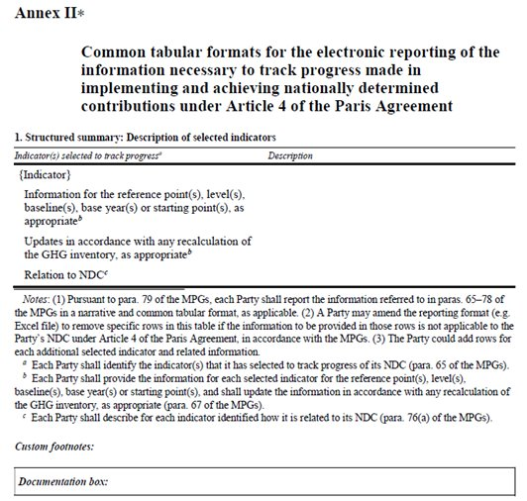
Common tabular formats for the electronic reporting of the information necessary to track progress made in implementing and achieving nationally determined contributions under Article 4 of the Paris Agreement
Decision 5/CMA.3
Guidance for operationalizing the modalities, procedures and guidelines for the enhanced transparency framework referred to in Article 13 of the Paris Agreement

Slide 4
Common Tabular Formats - Tables
MPG Section III | Related Tables from the Common tabular formats (CTF) | Reporting requirement Paragraph of the MPGs | Flexibility, for Parties that need flexibility in the light of their capacities (self-determined)
B. Description of a Party’s NDC | Appendix: Description of a Party’s NDC | 64
C: . Information necessary to track progress made in implementing and achieving its nationally determined contribution under Article 4 of the Paris Agreement | Table 1: Structured summary: Description of selected indicators | 65 | Parties can have their latest reporting year as three years prior to the submission of their national inventory report
 | Table 2. Structured summary: Definitions needed to understand NDC | 73
 | Table 3. Structured summary: Methodologies and accounting approaches – consistency with Article 4, paragraphs 13 and 14 of the Paris Agreement and with decision 4/CMA.1 | 71-77d
 | Table 4. Structured summary: Tracking progress made in implementing and achieving the NDC under Article 4 of the Paris Agreement | 77a -77dii
 | Table 12. Information necessary to track progress on the implementation and achievement of the domestic policies and measures implemented to address the social and economic consequences of response measures | 78

Slide 5
Common Tabular Formats - Tables
MPG Section III: | Related Tables from the Common tabular formats (CTF) | Reporting requirement | Flexibility, for Parties that need flexibility in the light of their capacities (self-determined)
D: Mitigation policies and measures, actions and plans, including those with mitigation co-benefits resulting from adaptation actions and economic diversification plans, related to implementing and achieving a nationally determined contribution under Article 4 of the Paris Agreement | Table 5. Mitigation policies and measures, actions, and plans, including those with mitigation co-benefits resulting from adaptation actions and economic diversification plans, related to implementing and achieving a nationally determined contribution under Article 4 of the Paris Agreement | 82-85 | Encouraged to report estimates of expected and achieved GHG emission reductions for its actions, policies, and measures
E. Summary of greenhouse gas emissions and removals | Table 6. Summary of greenhouse gas emissions and removals in accordance with the common reporting table 10 emission trends – summary | 91
F. Projections of greenhouse gas emissions and removals, as applicable | Table 7. Information on projections of greenhouse gas emissions and removals under a ‘with measures’ scenario | 92-101 | encouraged to report projections. Can instead report using a less detailed methodology or coverage.
 | Table 8. Information on projections of greenhouse gas emissions and removals under a ‘with additional measures’ scenario
 | Table 9. Information on projections of greenhouse gas emissions and removals under a ‘without measures’ scenario
 | Table 10. Projections of key indicators | 97
 | Table 11. Key underlying assumptions and parameters used for projections | 96 c

Slide 6
CTF tables for the electronic reporting of the information necessary to track progress made in implementing and achieving NDCs
NDC definition and methods
Appendix: Description of a Party´s NDC
Table 1: Description of selected indicators
Table 2: Definitions needed to understand the NDC
Table 3: Methodologies and accounting approaches
Current mitigation status and tracking progress
Table 4: Tracking progress
Table 5: Mitigation policies, measures, actions and plans (Achieved)
Table 6: Inventory summary
Projections and expected emissions reduction
Table 5: Mitigation policies, measures, actions and plans (expected)
Table 7: Projections “with measures” scenario
Table 8: Projections “with additional measures” scenario
Table 9: Projections “without measure” scenario
Table 10: Projections of key indicators
Table 11: Key underlying assumptions and parameters of projections
Response measures
Table 12. Information necessary to track progress on the implementation and achievement of the domestic policies and measures implemented to address the social and economic consequences of response measures

Slide 7
CTF Tables - NDC indicators
Appendix
Table 1
Table 2
Table 3
Table 4
Table 10
NDC description (targets)
Structured summary:
Indicators
Structured summary:
Definitions
Structured summary:
Methodologies
Structured summary:
Tracking progress
Projections:
Key projections indicators
Tracking progress

Slide 8
CTF Table 1 – 4: Structured summary
Table 1 -3 | Background information which is necessary to transparently track progress in the implementation and achievement of NDCs.
Table 1 | Indicator/s which are selected by the Party to track its progress in implementing and achieving its NDC
Table 2 | Definitions needed to understand each indicator, and other definitions needed to understand the NDCs
Table 3 | Accounting approach

Slide 9
Appendix
B. Description of a Party’s NDC, including updates
Each Party shall provide a description of its NDC, against which progress will be tracked:
# | NDC elements | Description
. | Target(s) and description, including target type(s)*, as applicable
b). | Target year(s) or period(s), and whether they are single-year or multi-year target(s), as applicable
C). | Reference point(s), level(s), baseline(s), base year(s) or starting point(s), and their respective value(s), as applicable
d). | Time frame(s) and/or periods for implementation, as applicable
e). | Scope and coverage, including, as relevant, sectors, categories, activities, sources and sinks, pools and gases, as applicable
f). | Intention to use cooperative approaches that involve the use of ITMOs under Article 6 towards NDCs under Article 4 of the Paris Agreement, as applicable
g). | Any updates or clarifications of previously reported information, as applicable
🡺 This table is to be used by Parties on a voluntary basis, however information items are shall
🡺 Parties with both unconditional and conditional targets in their NDC may add a row to the table to describe conditional targets
🡺 This information overlaps with NDC/ICTU, ensure consistency or explain changes/updates
* Examples of target types: economy-wide absolute emission reduction, emission intensity reduction, emission reduction below a projected baseline, mitigation co-benefits of adaptation actions or economic diversification plans, policies and measures, etc.

Slide 10
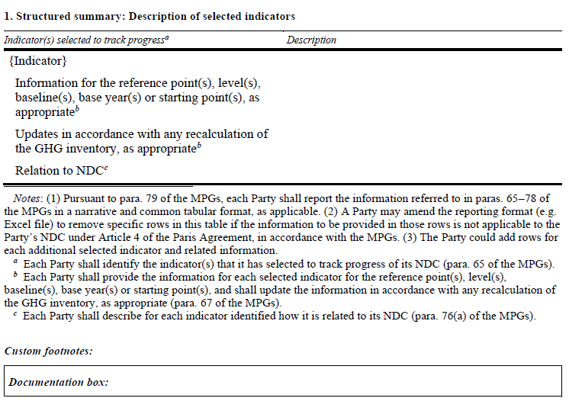
CTF table 1 – Description of selected indicators

Slide 11
Example CTF table 1 – Selected indicators
Source: Partnership on Transparency in Paris Agreement, Accounting for National Determined Contributions

Slide 12
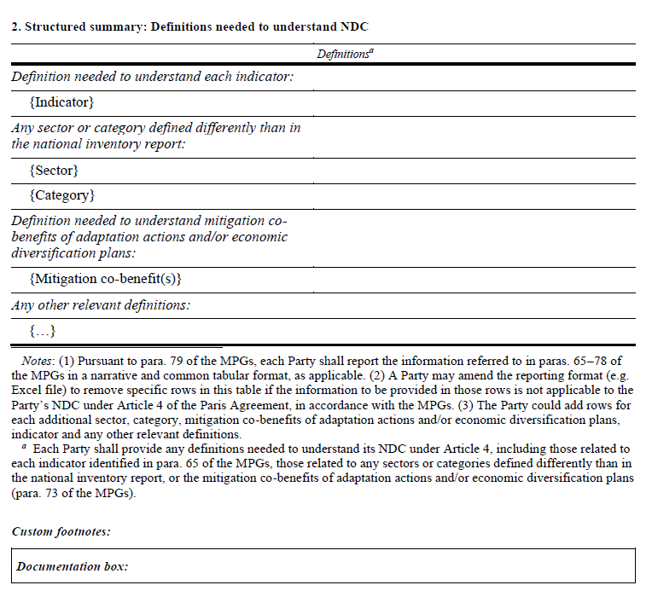
CTF Table 2

Slide 13
Linking CTF Table
Source: UNFCCC, CGE Training materials -Mitigation Assessment

Slide 14
CTF Table 3. Structured summary: Methodologies and accounting approaches
Methodologies and accounting approaches
Metrics and IPCC guidelines
Assumptions, key parameters, definitions, data sources, models
Consistency (communicated and implemented NDC; accounting for NDC and GHG inventory)
Changes (corrections, improvements, updates)
Inclusion of all relevant categories, and exclusions
Information associated with any cooperative approaches that involve use of ITMOs, if applicable

Slide 15
CTF Table 4: Structured summary
Table 4 | Tracking progress made in implementing and achieving the NDC under article 4 of the Paris Agreement
It allows for comparing the target or targets of the NDC to the progress made so far, by using selected indicators The part is relevant for Parties that participate in cooperative approaches that involve the use of internationally transferred mitigation outcomes (ITMOs) towards an NDC (this would be the participation in voluntary cooperation under Article 6 of the Paris Agreement), or authorizes the use of mitigation outcomes for international mitigation purposes other than achievement of the NDC (this would be, for example, the use of credits under the Carbon Offsetting and Reduction Scheme for International Aviation – CORSIA). This information is needed to transparently document the so-called ‘corresponding adjustments’

Slide 16
Table 4: Example of completed Table for tracking progress
Source: Partnership on Transparency in Paris Agreement, Accounting for National Determined Contributions

Slide 17
Example of completed table 4
(after the end of the NDC period)
Source: Partnership on Transparency in Paris Agreement, Accounting for National Determined Contributions

Slide 18
Example of completed table 4 (with ITMOs)
Source: Partnership on Transparency in Paris Agreement, Accounting for National Determined Contributions

Slide 19
CTF Table 5 -Mitigation policies and measures, actions and plans, including those with mitigation co-benefits resulting from adaptation actions and economic diversification plans, related to implementing and achieving an NDC
Mitigation policies and measures, actions, and plans, including those with mitigation co-benefits resulting from adaptation actions and economic diversification plans, related to implementing and achieving a nationally determined contribution under Article 4 of the Paris Agreement
Name | Description | Objectives | Type of instrument | Status | Sector(s) affected | Gases affected | Start year of implementation | Implementing entity or entities | Estimates of GHG emission reductions
 |  |  |  |  |  |  |  |  | Achieved | Expected

Slide 20
Table 5: Key terms to understand
Mitigation policies or Plans
Actions or measures
Mitigation co-benefits
Refers to a decision or set of decisions that a government takes to achieve certain objectives
policies could be defined as instruments (such as regulations, taxes, subsidies, and information instruments) that enable or incentivize concrete actions to be implemented (such as replacement of technology or changes in behavior)
Refers to a concrete activity or set of activities taken by a government to implement a policy or plan
Results from actions undertaken as part of adaptation and/or economic diversification plans where these generate emissions reductions and thereby contribute to achieving mitigation outcomes
Parties to the Paris Agreement may implement mitigation policies and measures, actions and plans in any sector of their economy and must report information on those actions, policies and measures that have the most significant impact on GHG emissions or removals and those impacting key categories in the national GHG inventory

Slide 21
CTF - Table 5:

Slide 22
Example of the CTF Table 5 for Mauritius
Name | Description | Objectives | Type of instrument | Status | Sector(s) affected | Gases affected | Start year of implementation | Implementing entity or entities | Estimates of GHG emission reductions (kt CO2 eq)
 |  |  |  |  |  |  |  |  | Achieved | Expected in 2030
Improved fuel economy of vehicles | Improvements in the fuel intensity of vehicles at the rate of 0.5% per year between 2022 and 2030, decreasing to 0.25% per year after 2030. | Technological improvements, better fuel economies. | Regulatory, economic | Planned | Transport | CO2, CH4, N2O | 2021 | MLTLR; TMRSU; Mauritius Standards Bureau (MSB); National Land Transport Authority (NLTA). |  | 6.7

Slide 23
CTF Table 6
Summary of greenhouse gas emissions and removals in accordance with the common reporting table 10 emission trends – summary
According to paragraph 91 of the MPGs, each Party that submits a stand-alone national inventory report shall provide a summary of its GHG emissions and removals. This information shall be provided for those reporting years corresponding to the Party’s most recent national inventory report, in a tabular format
Each Party, that submits a stand-alone national inventory report, shall provide a summary of its GHG emissions and removals.

Slide 24
CTF Table 7,8,9 - Projections of GHG emissions
With measures (shall)
Table 7
Implemented and adopted policies and measures
Projections
(with and without LULUCF)
With additional measures (may)
Table 8
Implemented, adopted and planned policies and measures
Without measures (may)
Table 9
Excludes all policies and measures after the cut-off date

Slide 25
7. Information on projections of greenhouse gas emissions and removals under a ‘with measures’ scenario
CTF table 7

Slide 26
8. Information on projections of greenhouse gas emissions and removals under a ‘with additional measures’ scenario 9. Information on projections of greenhouse gas emissions and removals under a ‘without measures’ scenario
CTF table 8, 9

Slide 27
10. Projections of key indicators
CTF table 10

Slide 28
CTF table 11
11. Key underlying assumptions and parameters used for projections

Slide 29
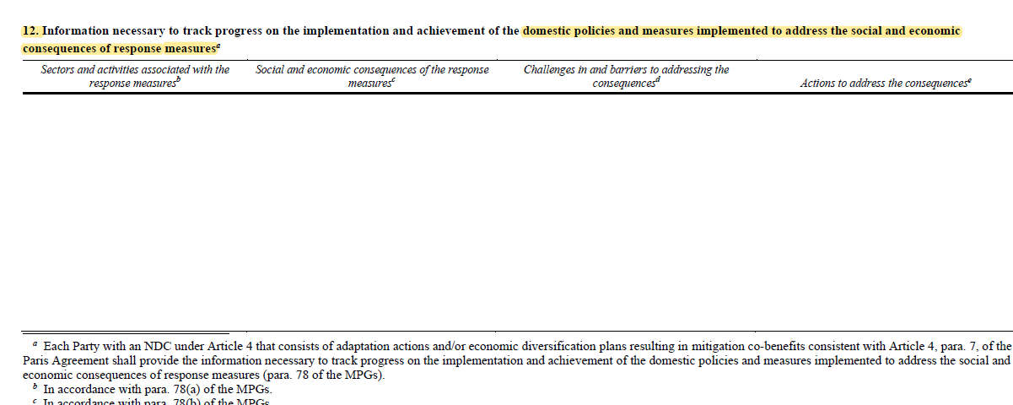
CTF tables 12: Response Measure

Slide 30
Understanding the tables
Progress of what?
What is the Target?
Description of NDC
Appendix
How will I track Progress?
Definitions
Definition necessary to understand the NDC
Table 1
Indicators
Description of the indicator
Table 2
Methodologies
Methodologies and accounting approaches
Table 3
How will I achieve the Target?
Policies, Measures, Actions & Plans
Mitigation policies, measures, action and plans
Table 5
Projections
Projections of GHG emissions and Removals
Table 7,8&9
Projections of indicators
Table10
Assumptions and parameters for projections
Table 11
Am I on Track?/ Did I achieve the target?
GHG Emissions and Removals
Summary of GHG inventory
Table 6
Make Assessment
Structured summary
Table 4

Slide 31
Thank you for your attention!
Khetsiwe Khumalo| Khetsiwe.khumalo@un.org
UNEP-CCC

